Slide 1

Title: Columbia Asia Hospital project.
Name: Dhanush S

Slide 2

Content Overview
Introduction
Objectives with Problem Statement
Data Overview
Methodology
Analysis & Key finding
Strategic Recommendations
Conclusion

Slide 3
Introduction
Columbia Asia Hospital is committed to delivering quality healthcare while optimizing its operations. In this project, I analyze hospital data to uncover insights on revenue generation, patient satisfaction, and departmental efficiency. By understanding key metrics, I aim to provide actionable recommendations that can enhance patient experience and improve the hospital’s overall performance.
Key Focus Areas:
Assessing the hospital's revenue streams and identifying high-revenue departments.
Analyzing patient satisfaction scores across demographics and departments.
Identifying departments with high patient volume for potential staffing needs.
Developing strategies for targeted patient discounts to improve satisfaction and loyalty.

Slide 4
Objectives
To analyze the hospital’s revenue streams and identify departments that contribute most to overall income.
To evaluate patient satisfaction scores across demographics and departments to understand key drivers of patient experience.
To assess departmental demand and identify potential areas for staffing improvements.
To provide actionable strategies and recommendations for targeted discounts and improved patient engagement.

Slide 5
Problem Statement
Columbia Asia Hospital is focused on optimizing its operational performance and enhancing patient satisfaction. The hospital seeks a comprehensive analysis to identify revenue-driving departments, understand patient demographics, and evaluate patient satisfaction across various age and racial groups. Additionally, assessing patient wait times, discount eligibility, and department-wise demand is crucial for creating effective strategies to improve patient engagement and streamline hospital services.

Slide 6
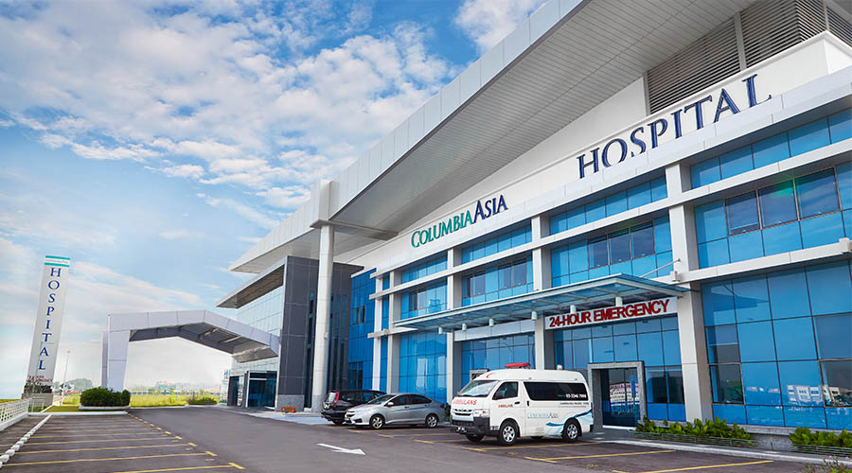
Data Overview
Data Source:
The dataset includes comprehensive records of patient visits, doctor referrals, and billing information from Columbia Asia Hospital. Key tables, such as doctor_info and hospital_er, capture details on patient demographics, appointment fees, satisfaction scores, and wait times, offering a full view of hospital operations and patient experience.
Tools Used:
SQL for data querying and extraction.
Power BI for data visualization and insights generation.

Slide 7
Methodology
Step 1: Data Extraction and Preprocessing
Extracting and cleaning data using Excel and SQL to aggregate metrics on patient demographics, billing, department referrals, and satisfaction scores.
Step 2: Patient and Department Analysis
Analyzing patient satisfaction by demographics like age, race, and department.
Evaluating departmental performance based on revenue, patient volume, and wait times.
Step 3: Financial and Operational Insights
Assessing revenue contributions by department and identifying high-demand areas for staffing needs.
Examining correlations between wait times and satisfaction scores to pinpoint experience factors.
Step 4: Recommendations
Providing targeted discount and staffing recommendations to improve patient satisfaction and operational efficiency.
Suggesting patient engagement initiatives based on satisfaction scores to foster loyalty.

Slide 8
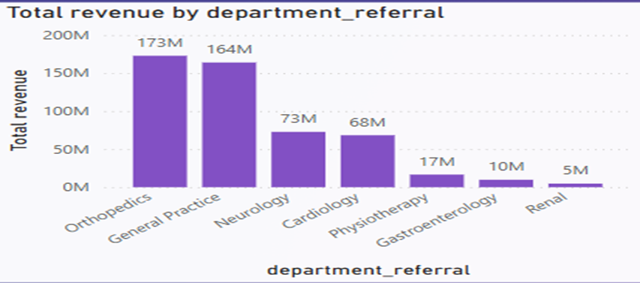
Analysis & Key finding
Revenue by Department
Objective:
Identify the top revenue-generating departments to understand which areas contribute the most to hospital income.
Analysis:
Orthopedics and General Practice emerged as the leading departments in terms of total revenue generated, highlighting key areas of financial strength for the hospital.
Insights:
These high-revenue departments offer potential for targeted investment to further boost income. Expanding services or resources in these departments could support growth and increase patient intake.

Slide 9
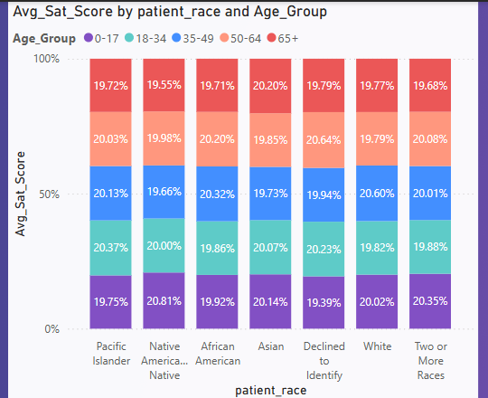
Analysis & Key finding
Patient Satisfaction Across Demographics
Objective:
Analyze patient satisfaction scores by age and racial demographics to identify groups with varying satisfaction levels.
Analysis:
The analysis revealed that specific age and racial groups exhibited distinct satisfaction levels, suggesting varying needs and experiences across demographics.
Insights:
Targeting improvement efforts toward lower-satisfaction demographics may enhance patient experience and foster a more positive perception among diverse patient groups.

Slide 10
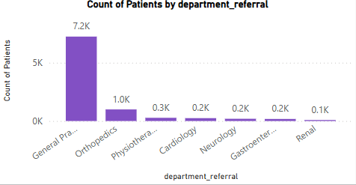
Analysis & Key finding
Departmental Patient Volume
Objective:
Evaluate patient volume by department to identify high-demand areas that may require additional resources.
Analysis:
General Practice and Orthopedics had the highest patient volume, indicating these departments are essential for patient care and could benefit from increased staffing.
Insights:
Prioritizing these departments for staffing and resource allocation could help manage demand and improve patient flow.

Slide 11
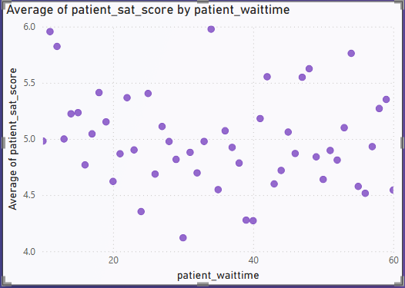
Analysis & Key finding
Wait Time Impact on Satisfaction
Objective:
Determine the impact of patient wait times on satisfaction to understand how operational efficiency affects patient experience.
Analysis:
A negative correlation was observed between wait times and satisfaction scores, with longer waits leading to lower satisfaction.
Insights:
Efforts to reduce wait times, especially in high-demand departments, could significantly improve patient satisfaction. Additionally, implementing efficient scheduling or queue management systems could help reduce congestion during peak hours.

Slide 12
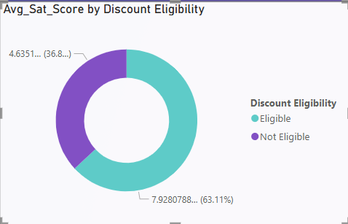
Analysis & Key finding
Discount Distribution and Eligibility
Objective:
Analyze the relationship between discount levels and patient satisfaction to assess the effectiveness of discounts on patient experience.
Analysis:
Patients receiving discounts reported better satisfaction scores, indicating that targeted discounts can positively influence patient satisfaction.
Insights:
Implementing targeted discount strategies for eligible patients may enhance loyalty and satisfaction, especially among cost-sensitive patients.

Slide 13
Strategic Recommendations
Enhance High-Demand Department Efficiency
Insight: High patient volume in departments like General Practice and Orthopedics indicates potential bottlenecks and increased wait times, impacting patient satisfaction.
Recommendation:
Prioritize hiring additional staff in high-demand departments to manage patient influx effectively.
Implement streamlined scheduling and queue management systems to reduce patient wait times and enhance service efficiency.

Slide 14
Strategic Recommendations
2. Tailored Patient Satisfaction Initiatives
Insight: Patient satisfaction scores vary significantly across different age groups and racial demographics, with some groups consistently reporting lower satisfaction.
Recommendation:
Develop targeted patient engagement strategies for age groups and racial demographics showing lower satisfaction scores.
Customize services and communication based on demographic needs to provide a more personalized patient experience.

Slide 15
Strategic Recommendations
3. Optimize Discount Strategy for Improved Patient Retention
Insight: Patients receiving medium to high-level discounts reported higher satisfaction, indicating a positive impact of discounts on patient experience.
Recommendation:
Expand the discount program to include more patients who may benefit from financial incentives, especially those with high out-of-pocket expenses.
Introduce loyalty discounts or follow-up visit discounts to encourage repeat visits and build long-term patient relationships.

Slide 16
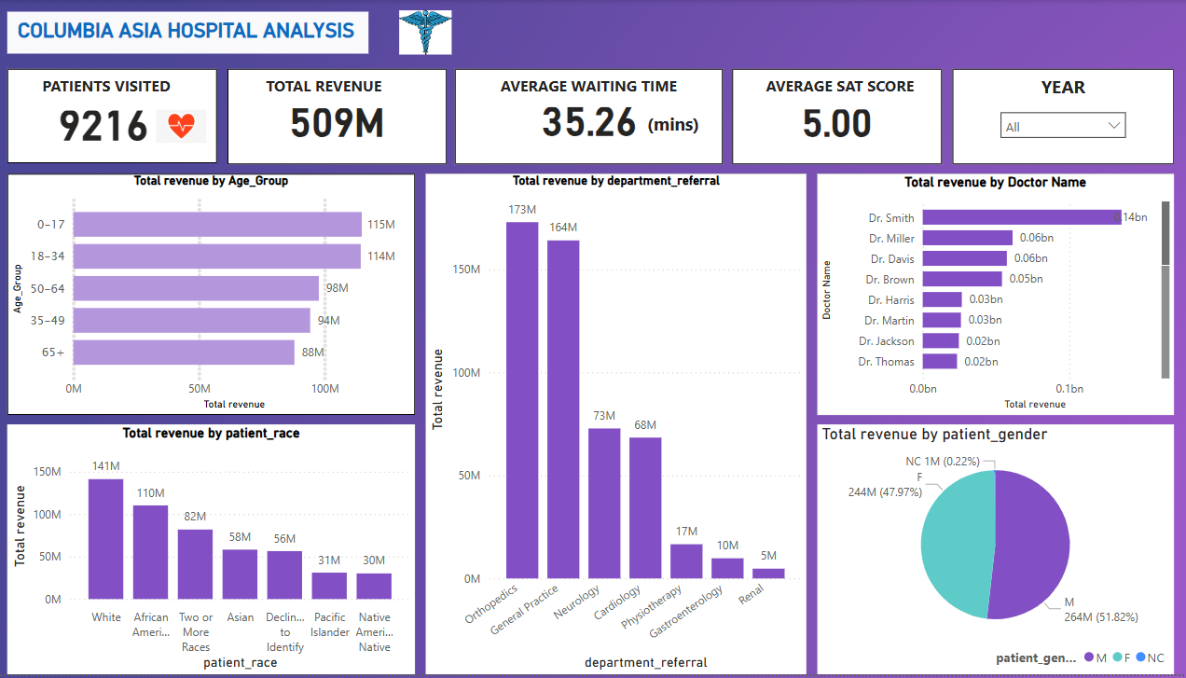
Final Dashboard (Main Tab)

Slide 17
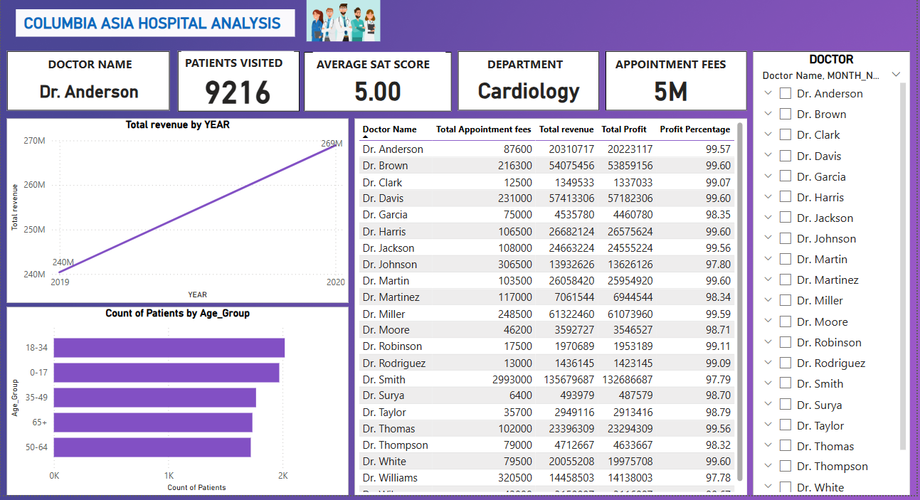
Final Dashboard (Doctor’s Tab)

Slide 18
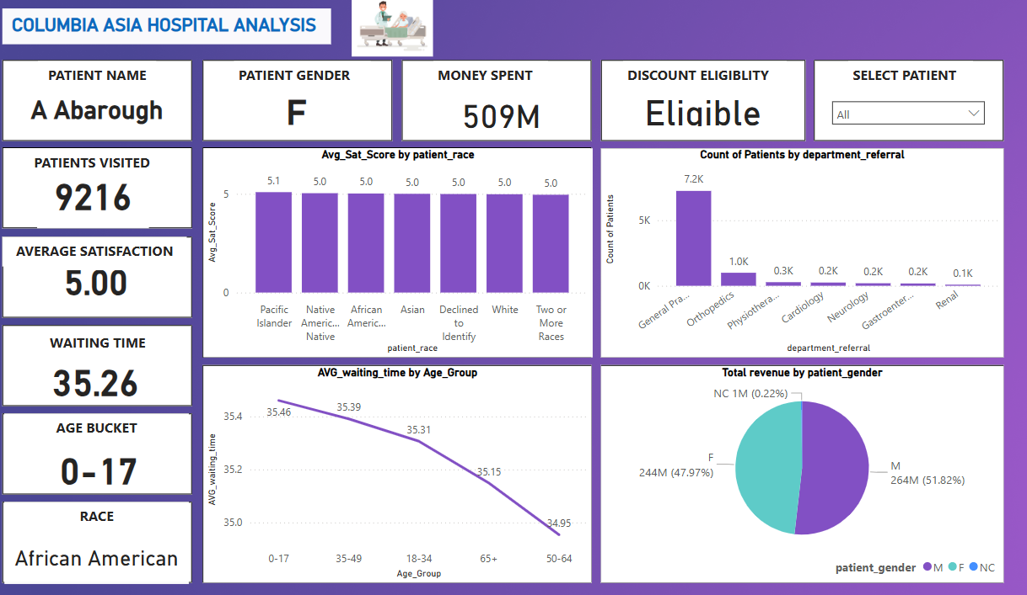
Final Dashboard (patients Tab)

Slide 19
Conclusion
By focusing on enhancing the efficiency of high-demand departments and tailoring patient satisfaction initiatives, Columbia Asia Hospital can address the operational challenges impacting patient experience and overall revenue.
Leveraging targeted discount strategies will improve patient retention, especially among cost-sensitive demographics, leading to increased loyalty and long-term engagement.
Strategic improvements in staffing, service customization, and financial incentives will enable Columbia Asia Hospital to elevate patient care standards, boost satisfaction scores, and drive sustained revenue growth.
Consistent implementation of these strategies will not only enhance the hospital’s operational performance but also strengthen its reputation as a preferred healthcare provider.

Slide 20


